Slide 1

4.3 - Solving Radical Equations
and Inequalities
Homework Check
Skills Check
Lesson Presentation
Holt McDougal Algebra 2
Holt Algebra 2

Slide 2
Homework Check

Slide 3
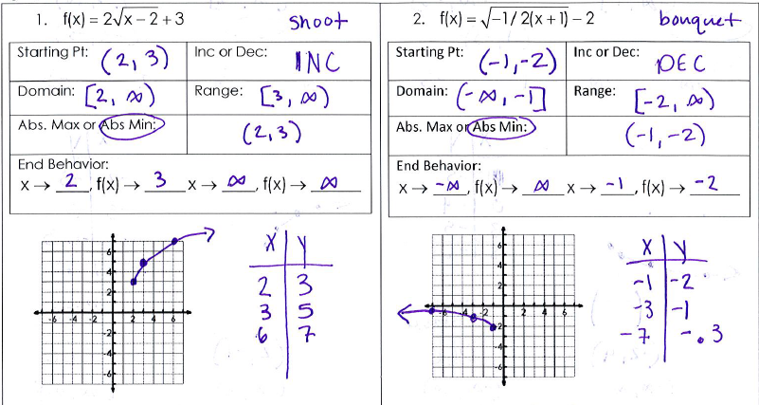
Homework Check

Slide 4
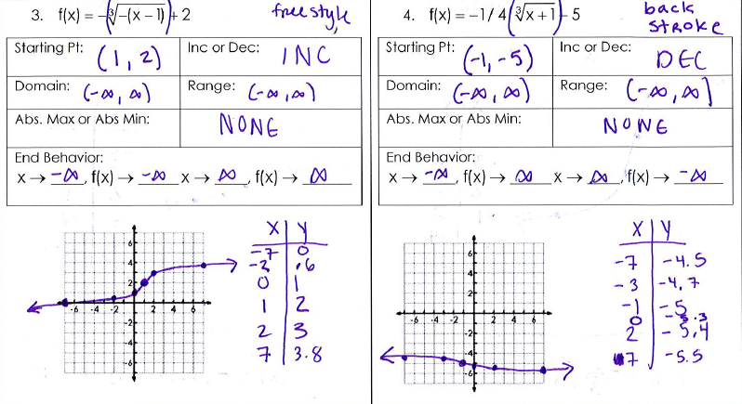
Homework Check

Slide 5
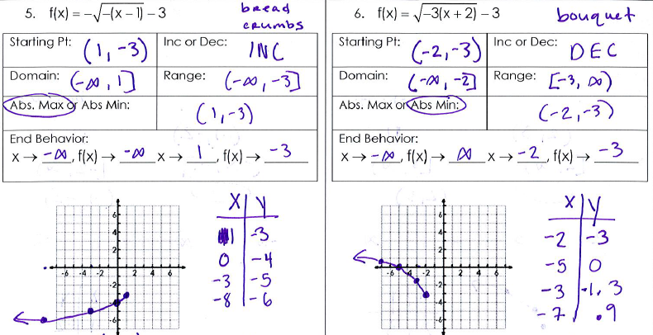
Homework Check

Slide 6
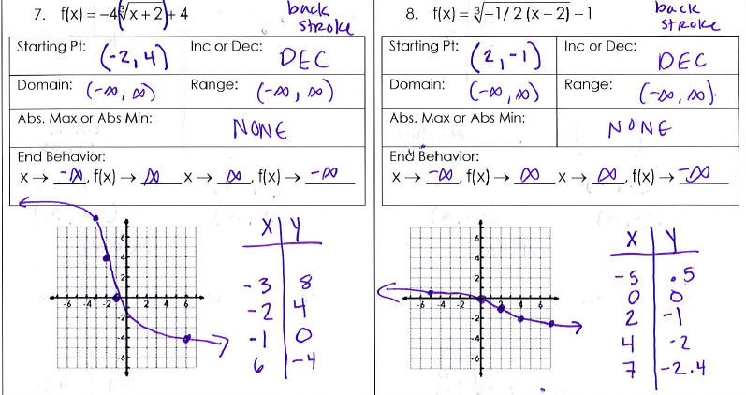
Homework Check

Slide 7
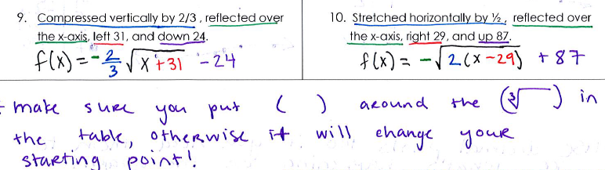
Homework Check

Slide 9
Skill Check

Slide 10
Objective
Solve radical equations.

Slide 11
A radical equation contains a variable within a radical. Recall that you can solve quadratic equations by taking the square root of both sides. Similarly, radical equations can be solved by raising both sides to a power.

Slide 12
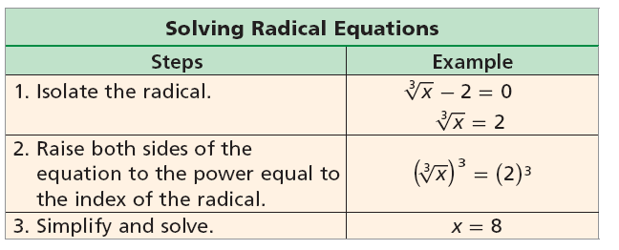

Remember!
For a square root, the index of the radical is 2.

Slide 13









Example 1: Solving Equations Containing One Radical
Solve each equation.
Check
Subtract 5.
Simplify.
Square both sides.
✓
Simplify.
Solve for x.

Slide 14









Example 2: Solving Equations Containing One Radical
Solve each equation.
Check
7 5x − 7 84
3
=
Divide by 7.
7
7
7
Simplify.
Cube both sides.
✓
Simplify.
Solve for x.

Slide 15


Example 3: Solving Equations Containing Two Radicals
Solve
Square both sides.
7x + 2 = 9(3x – 2)
Simplify.
7x + 2 = 27x – 18
Distribute.
20 = 20x
Solve for x.
1 = x

Slide 16




You Try! Example 4
Solve each equation.
Cube both sides.
x + 6 = 8(x – 1)
Simplify.
x + 6 = 8x – 8
Distribute.
14 = 7x
Solve for x.
2 = x
Check
2 2
✓

Slide 17
Raising each side of an equation to an even power may introduce extraneous solutions.
You don’t have to worry about extraneous solutions when solving problems to an odd power.

Slide 18


Example 5
Step 1 Solve for x.
Square both sides.
–3x + 33 = 25 – 10x + x²
Simplify.
0 = x² – 7x – 8
Write in standard form.
0 = (x – 8)(x + 1)
Factor.
x – 8 = 0 or x + 1 = 0
Solve for x.
x = 8 or x = –1

Slide 19


Example 5 Continued
Method 2 Use algebra to solve the equation.
Step 2 Use substitution to check for extraneous solutions.
3 –3
6 6
x
✓
Because x = 8 is extraneous, the only solution is x = –1.

Slide 20


You Try! Example 6
Step 1 Solve for x.
Square both sides.
2x + 14 = x² + 6x + 9
Simplify.
0 = x² + 4x – 5
Write in standard form.
0 = (x + 5)(x – 1)
Factor.
x + 5 = 0 or x – 1 = 0
Solve for x.
x = –5 or x = 1

Slide 21

You Try! Example 6 Continued
Method 1 Use algebra to solve the equation.
Step 2 Use substitution to check for extraneous solutions.
2 –2
x
4 4
✓
Because x = –5 is extraneous, the only solution is x = 1.

Slide 22


Example 7
Method 2 Use algebra to solve the equation.
Step 1 Solve for x.
Square both sides.
–9x + 28 = x² – 8x + 16
Simplify.
0 = x² + x – 12
Write in standard form.
0 = (x + 4)(x – 3)
Factor.
x + 4 = 0 or x – 3 = 0
Solve for x.
x = –4 or x = 3

Slide 23




Example 7 Continued
Method 1 Use algebra to solve the equation.
Step 2 Use substitution to check for extraneous solutions.
✓
✓
So BOTH answers work!!! x = –4 or x = 3

Slide 24

Example 8: Solving Equations with Rational Exponents
Solve each equation.
1
(5x + 7) = 3
3
Cube both sides.
5x + 7 = 27
Simplify.
5x = 20
Factor.
x = 4
Solve for x.

Slide 25
Example 9: Solving Equations with Rational Exponents
1
2x = (4x + 8)
2
Step 1 Solve for x.
Raise both sides to the reciprocal power.
1
(2x)² = [(4x + 8) ]²
2
4x² = 4x + 8
Simplify.
4x² – 4x – 8 = 0
Write in standard form.
4(x² – x – 2) = 0
Factor out the GCF, 4.
4(x – 2)(x + 1) = 0
Factor.
4 ≠ 0, x – 2 = 0 or x + 1 = 0
Solve for x.
x = 2 or x = –1

Slide 26
Example 9 Continued
Step 2 Use substitution to check for extraneous solutions.
1
1
2x = (4x + 8)
2x = (4x + 8)
2
2
1
1
2(2) (4(2) + 8)
2(–1) (4(–1) + 8)
2
2
1
1
4 16
–2 4
2
2
4 4
–2 2
x
✓
The only solution is x = 2.

Slide 27
Example 10
1
3(x + 6) = 9
2
1
Raise both sides to the reciprocal power.
[3(x + 6) ]² = (9)²
2
9(x + 6) = 81
Simplify.
9x + 54 = 81
Distribute 9.
9x = 27
Simplify.
x = 3
Solve for x.

Slide 28
Cw/Hw
Pg 240 #3-22
2nd 2 columns, 54

