Slide 1
Welcome!!
Mrs. Sweet
Honors Algebra 2
Remote Learning 2020!

Slide 2
Today’s Schedule:
Class Expectations
Getting to know you!
What’s next?

Slide 3
Remind 101
1st block: @1sweetalg
2nd block: @2sweetalg
to 81010

Slide 4
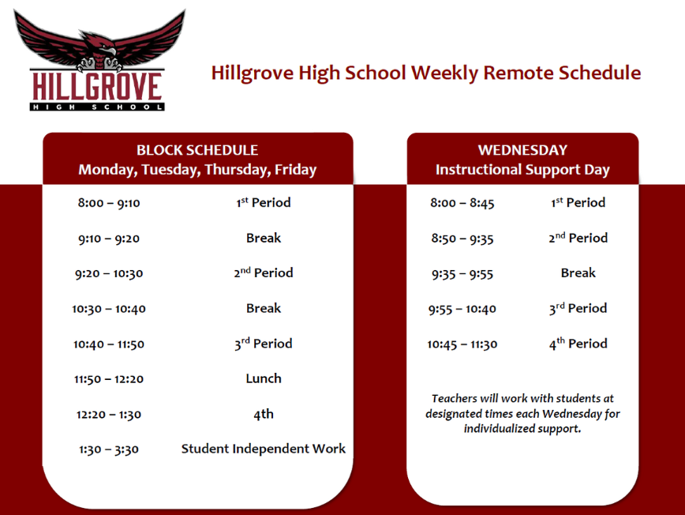

Slide 5
Zoom Etiquette
Attend class every Monday, Tuesday, Thursday, and Friday.
Class will begin promptly at the scheduled time. Attendance will be taken.
I will launch the live session 3-4 minutes prior to the start time. You will be in the waiting room at first.
Your device name must be your name when logging in, or else you will not be given permission to enter the classroom

Slide 6
Zoom Etiquette
Camera on, dressed appropriately for school
Mute on (to unmute when called on press your space bar, press again to mute)
If you have a question, press the “hand” icon to raise your hand
If you would like to type your question instead of speak, you may do so in the zoom chat feature
Keep your camera still
Stay on task
What if I can’t join the live session?

Slide 7
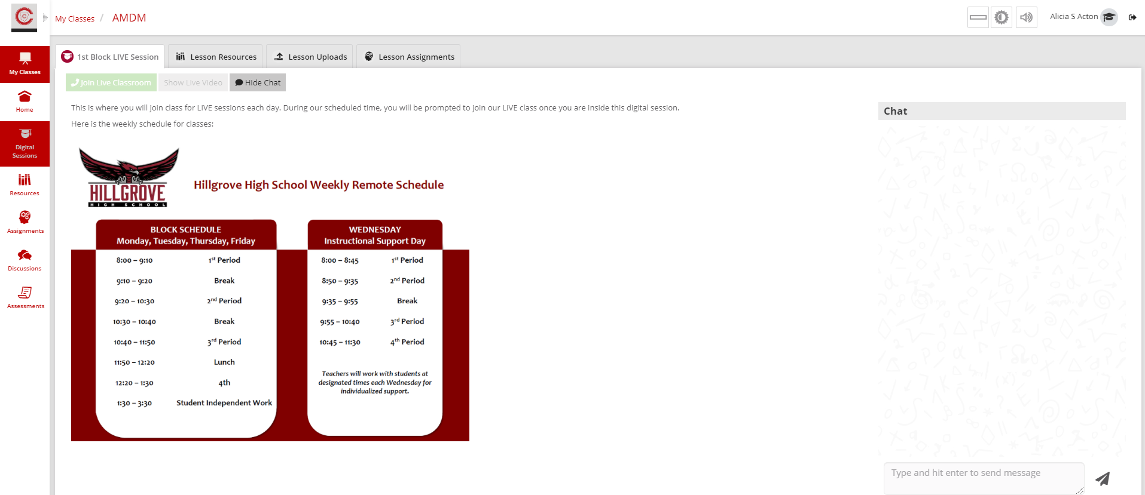
Check here: Mrs. Sweet will put a Zoom link in this digital session chat each day to join in case the “Join Live Classroom” button is grayed out.
What if I can’t join the live session?

Slide 8
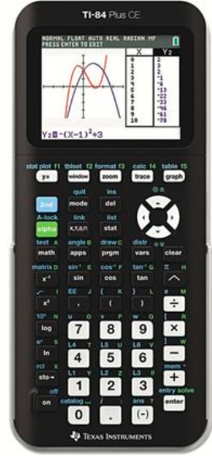
Supplies:
Graphing Calculator
TI-84
TI-84 Plus
TI-84 Plus CE
Binder
Paper
Colored Pens/Highlighters (optional)

Slide 9
BLOG and Remind!!

Slide 10
Let’s Begin!!! Desmos Survey

Slide 11
Honors Algebra 2
What is the terminology we use to analyze numbers and functions?

Slide 12
Imaginary Numbers
Real Numbers

Slide 13
Imaginary Numbers
Real Numbers
(Fractional) Terminating or
repeating decimals
Rational Numbers
Irrational Numbers
Integers
Whole Numbers
$$\sqrt[3]{90}$$
Counting/Natural Numbers
Complex Numbers
a + bi 7+3i 17 -2i

Slide 14
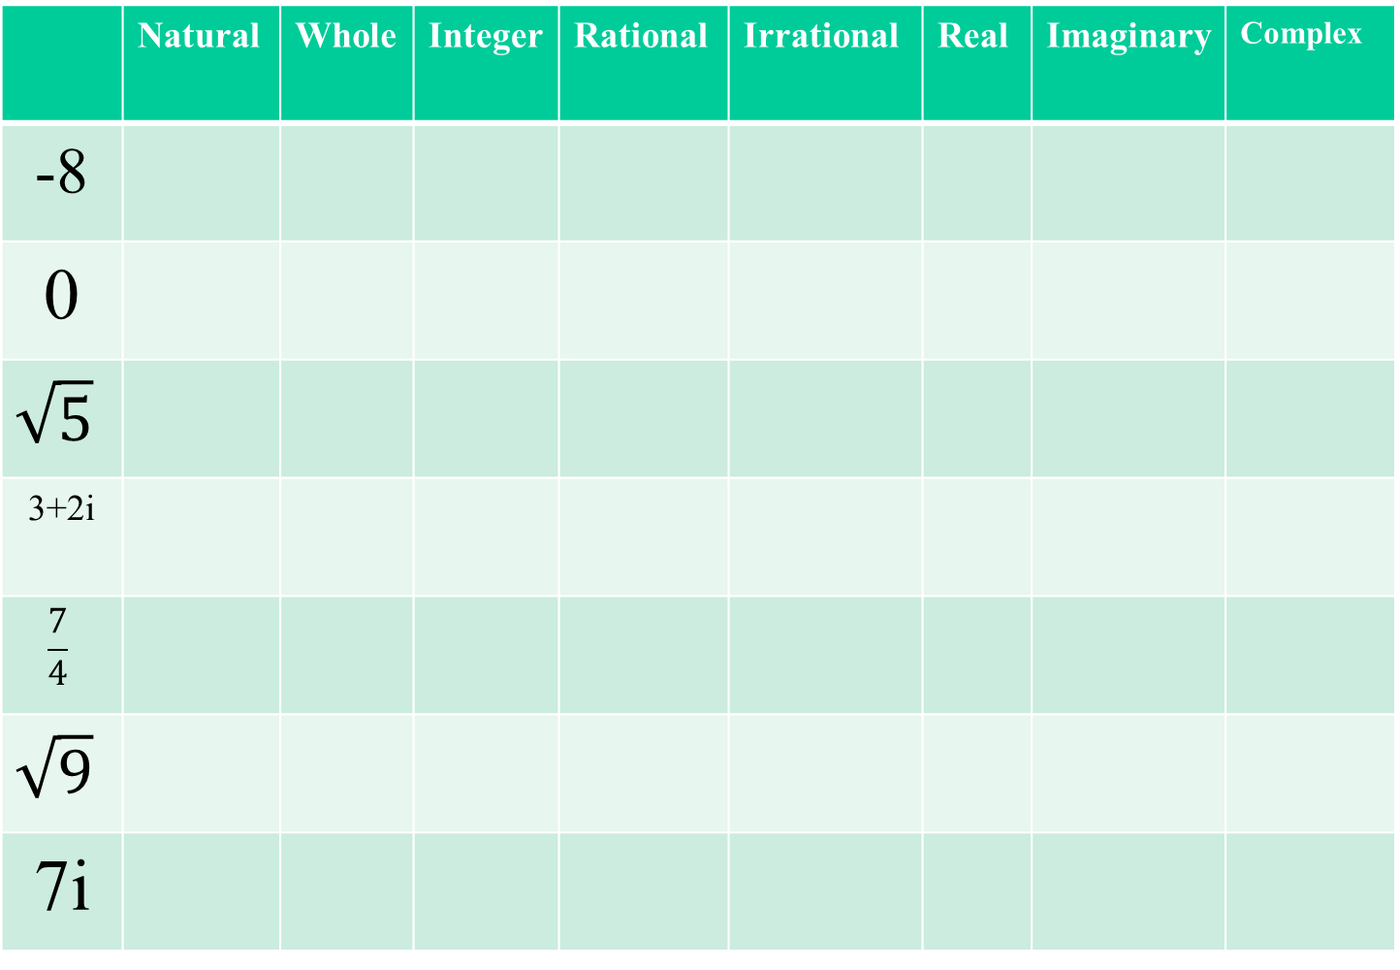
Into which groups does each number go?
 | Natural | Whole | Integer | Rational | Irrational | Real | Imaginary | Complex
-8
0
$$\sqrt{5}$$
3+2i
$$\frac{7}{4}$$
$$\sqrt{9}$$
7i

Slide 15
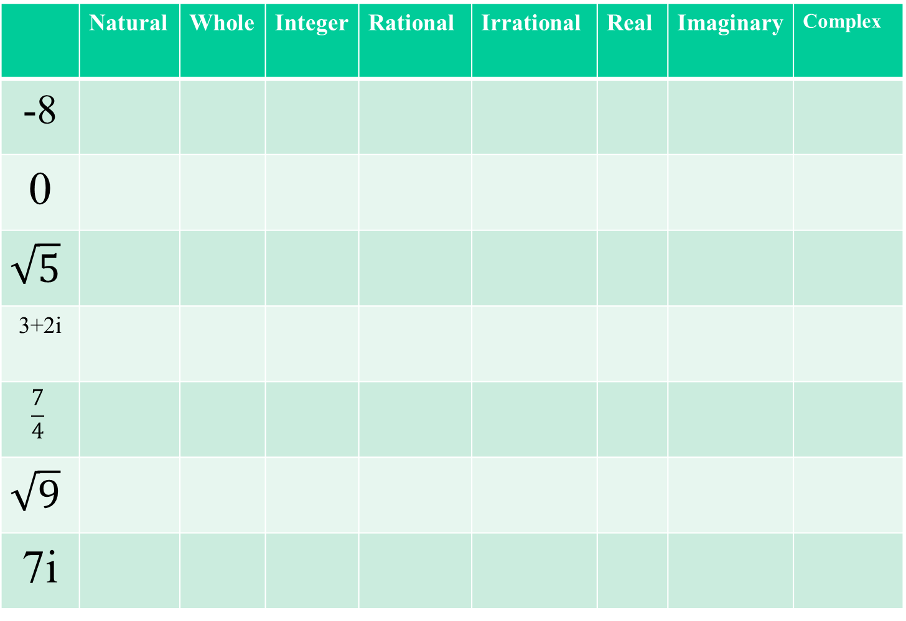
Into which groups does each number go?
 | Natural | Whole | Integer | Rational | Irrational | Real | Imaginary | Complex
-8
0
$$\sqrt{5}$$
3+2i
$$\frac{7}{4}$$
$$\sqrt{9}$$
7i

Slide 16
Homework:
*Finish WS
*Sign up for Remind

