Slide 1
Homework Check

Slide 2
What is the terminology we use to analyze a function?

Slide 3
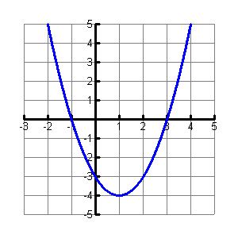
What can you tell me about this graph?

Slide 4
Notation
Interval – represents an interval as a pair of numbers. The numbers are the endpoints of the interval. Parentheses and/or brackets are used to show whether the endpoints are excluded or included (what we will use)
Set – using inequalities to describe the values (what you probably used to use)

Slide 5
Notation
Interval :
[ ] means you include the number in the brackets (like less than or equal to)
( ) means you don’t include it (like just less than)

Slide 6
Domain
Range
The x-values in the graph
Write from LEFT to RIGHT
Independent
What you put into the function
The y-values in the graph
Write from BOTTOM to TOP
Dependent
What you get out of the function

Slide 7
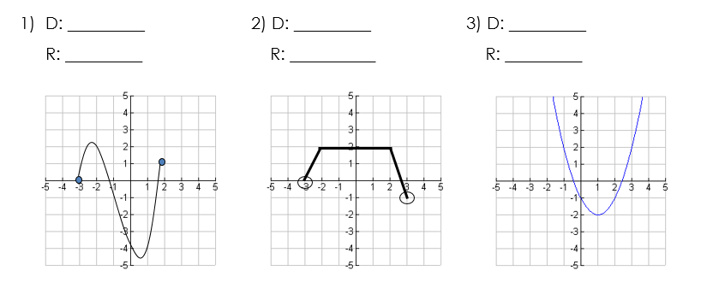
What is the domain and range?

Slide 8
Interval of Increase/Decrease
Sweep from left to right and notice what happens to the y-values
Increasing goes up (L to R)
Decreasing falls down (L to R)
Constant is a horizontal graph

Slide 9
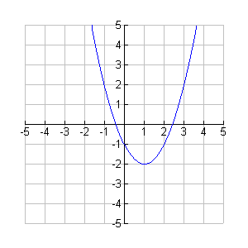
Give the intervals of increase and decrease

Slide 10
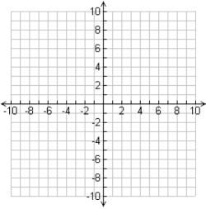
Axis of Symmetry
The line over which a graph will perfectly match
itself. This only exists
for some functions.
Always in the form
x = _______

Slide 11
Extrema
Maximums
Minimums
The highest point on the graph
The lowest point on the graph

Slide 12
Give the extrema:

Slide 13
Zeros/Roots/Solutions/Intercepts
The points where the graph crosses the x-axis.
Called a zero, because if you plug in the x-value, you get out a zero.
Called the solution because it is a solution to the equation when set equal to zero.

Slide 14
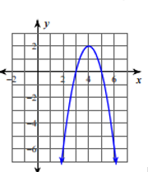
Give the solutions:

Slide 15
Intercepts
x-intercept – the point at which the line intersects the x-axis at (x, 0)
y-intercept – the point at which the line intersects the y-axis at (0, y)

Slide 16
End Behavior
What a function keeps doing after it leaves the graph.
As x goes to the right, where does y go?
As x goes to the left, where does y go?
Your answers will be: None, a number, , or . Usually one of the last two.

Slide 17
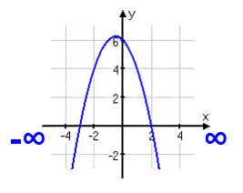
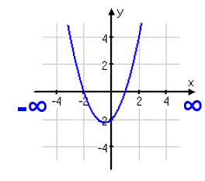
End Behavior

Slide 18
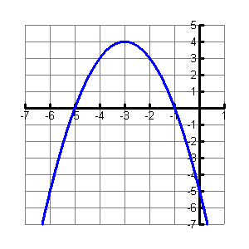
Analyze this graph
domain, range, axis of symmetry, extrema, intervals of increase and decrease, zeros, and end behavior

